Slide 1
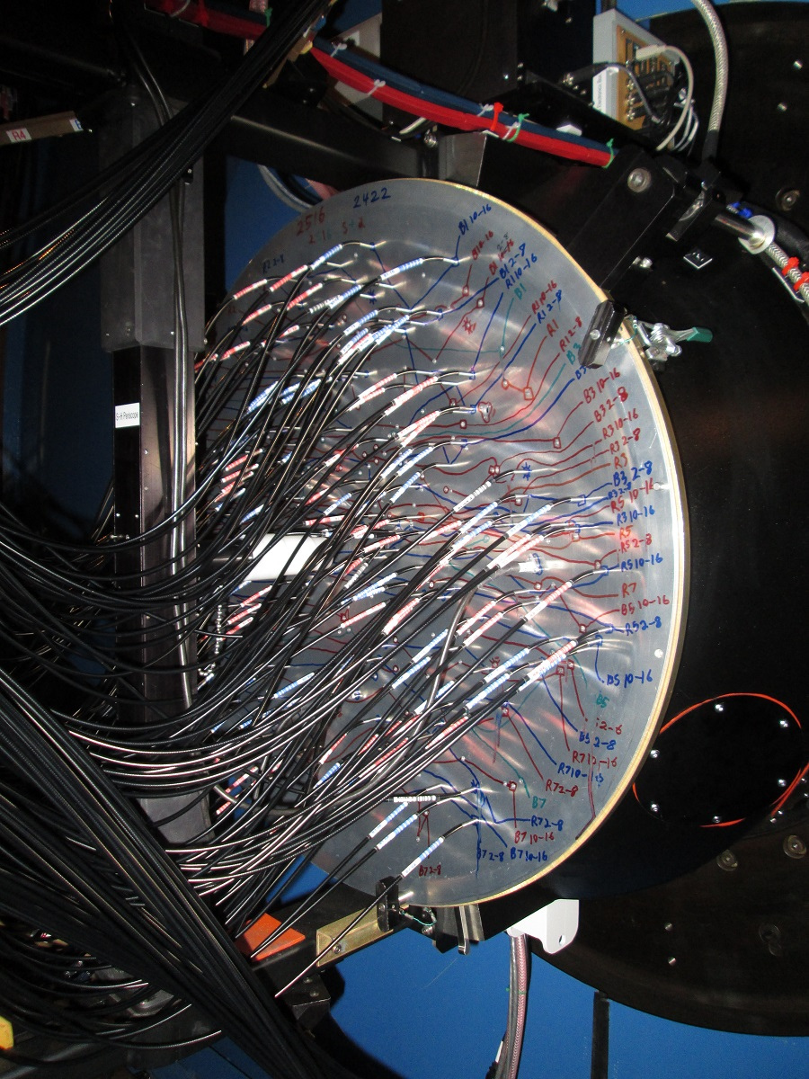
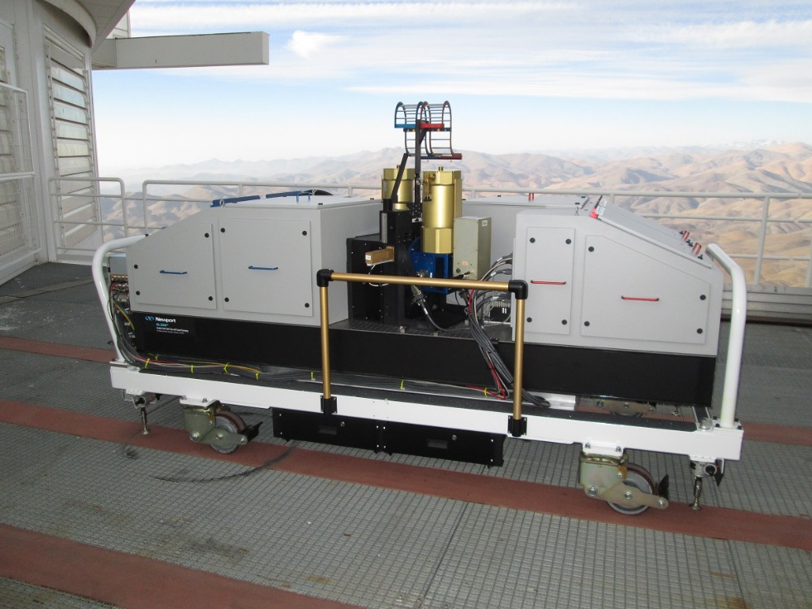
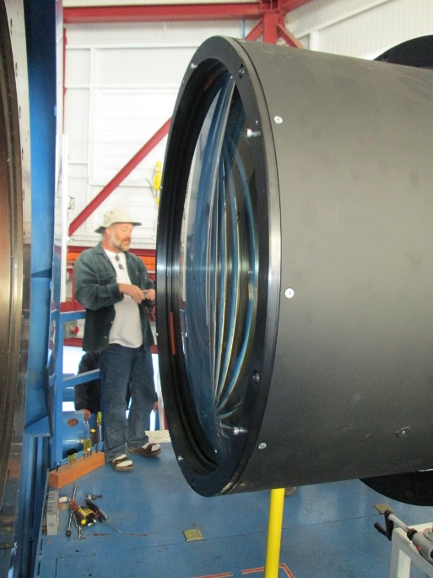
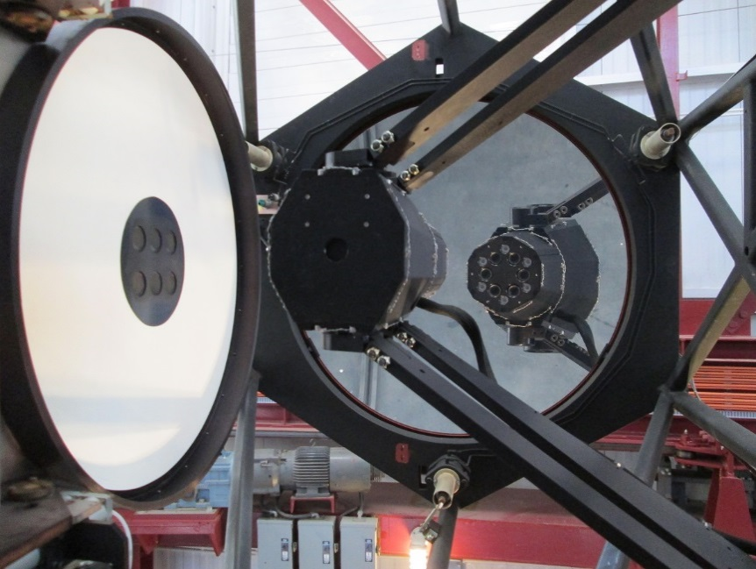
M2FS: The Michigan/Magellan Fiber
System: Data Reduction Overview

Slide 2
M2FS: Terminology
Data are defined by:
Field — The set of targets observed in a
single observation/set of exposures.
Plate — The physical plate on which the
field is drilled.
Configuration — The full set of instrument
parameters that are used to carry out an
observation.
Setup — The full combination of field, plate,
and configuration used for a specific set of
observations.

Slide 3
M2FS: Configurations
Configurations are defined by:
MSpec Side — B or R spectrograph.
Resolution — HiRes (Echelle + cross-disperer),
or LoRes (Standard/Echellette grating)
Grating Angles — El/Az (HiRes) or El (LoRes)
Blocking Filters — Isolate orders/BK7 in LoRes
Focus — B/R separate; depends slightly on
temperature.
Fiber Slits — Wide open to 45-microns; 8 pos.
CCD binning — Somewhat complicated, but
many options available; depend on amplifiers.
Readout Details — Speed; full/subraster.

Slide 4
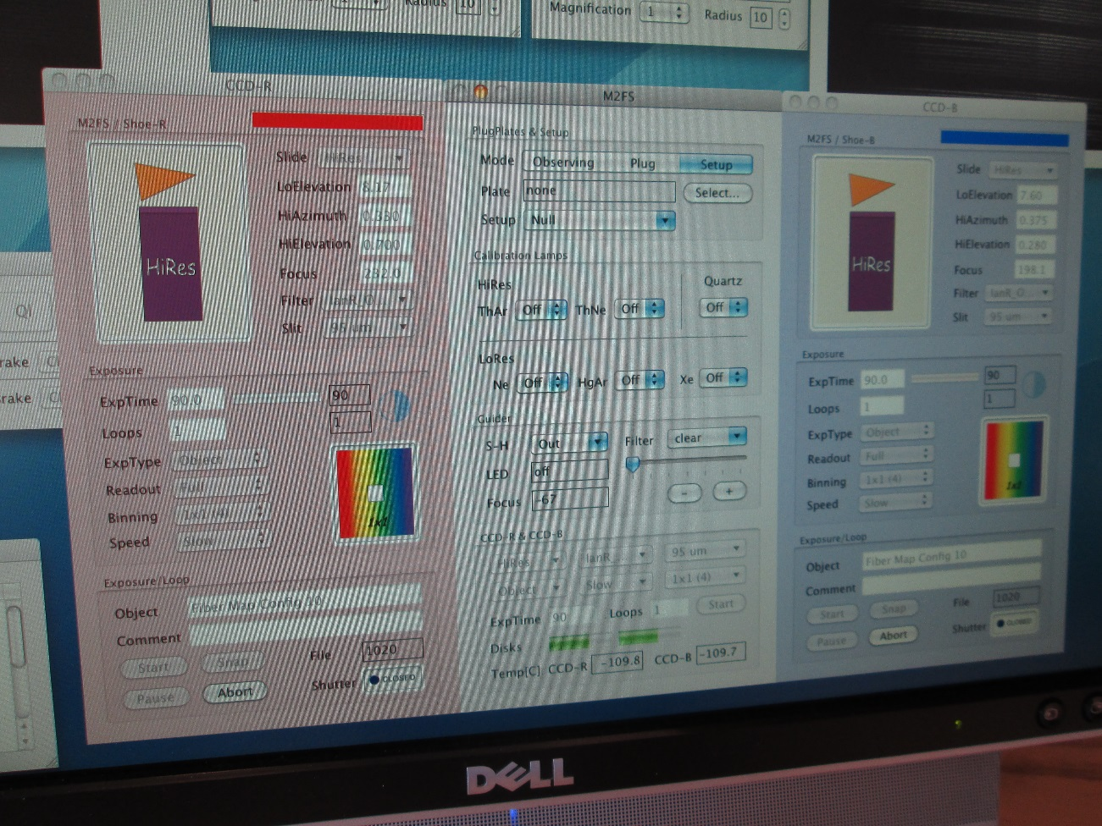
M2FS: Basics
Users select
configuration
variables via
instrument GUI.
Parameters can
be saved and
read from files.

Slide 5
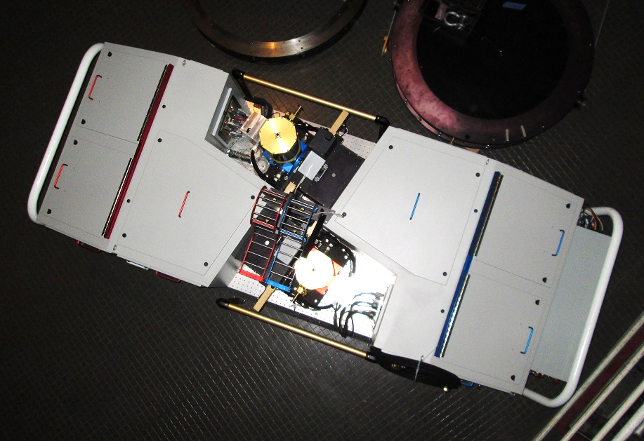
CCDs
Blue Side
Red Side
Identical Channels; names are relics.

Slide 6
M2FS Optical Layout: Theory/HiRes
xDisp Prism
Cam/Coll
Echelle

Slide 7
M2FS Optical Layout: Theory/LoRes
Cam/Coll
Grating

Slide 8
M2FS: Configurations
Through commissioning (Aug 2013) and
two science runs (Nov 2013 and Feb 2014),
we now have 15 configurations defined:
Config 1 — Mgb filter; HiRes; 2x2; 180 mic slit;
grating angles.
Config 5b — Hot Jupiter filter; HiRes; 1x1; 45
mic slit; grating angles.
Config 9 — BK-7; 3700-5700A; LoRes; 2x2; 180
mic slit; grating angle.
Config 12 — Halpha/Li filter; HiRes; 1x2; 75 mic
slit; grating angles.

Slide 9
M2FS: Resources to Users. I.
Data logs (active) — Primary source of
information for images. IMAGE HEADERS
MAY NOT ALWAYS BE RELIABLE.
Data repository (active) — Available at
https://m2fs.astro.lsa.umich.edu/data/
(m2fs/m2fsdata)
Configuration parameter files — Saved at
the telescope; available if/as needed.
Data reduction scripts (not active) — TBD

Slide 10
M2FS: Data Characteristics. I.
Data format — Single extension FITS.
Multi-extension possible if demand is high.
Amplifiers — Currently support 1, 2 or 4-amp, readouts. At telescope, files are saved as
fNNNNcM.fits
where f=r,b, N=frame number, M=amp.
Data Directories — Standard practice is to sort by ut date: /utYYYYMMDD
Example — /feb2014/ut20140218/b0198c2.fits

Slide 11
M2FS: Data Headers
TCS Information — Telescope position, time of observation, orientation of dome, etc. RELIABLE.
Instrument Status — Environment temps, CCD temps, CCD readout details, configuration parameters, etc. RELIABLE.
Field/Plate Information — Name of plate, name of target field, full fiber cross indexing and information with target ids. NOT YET RELIABLE. Even when information is properly entered, fiber status may be wrong. Always check log.

Slide 12
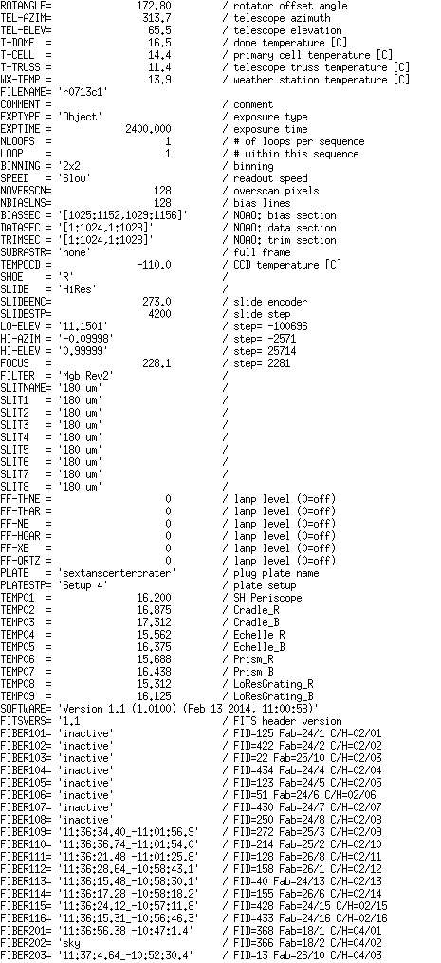
M2FS: Data Headers
Exposure info
CCD sampling
Slit assignments
System temps
Fiber mapping

Slide 13
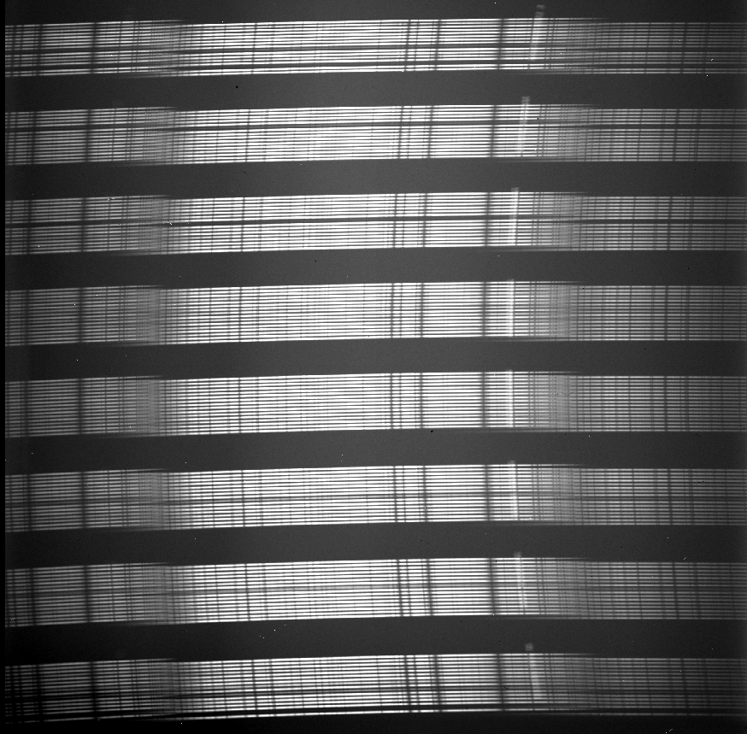
M2FS: Fiber IDs
Each group of 16 fibers represents a ‘cassette’ or ‘tetris’.
The B and R side CCDs have different mappings of cassette/tetris and fiber numbers.
Fibers designated as SC-FF where S=‘side’ (R or B), C=Cassette #, FF=Fiber # in cassette (2 digit)

Slide 14
M2FS: Fiber IDs RED SIDE
A=128
8
7
6
5
4
3
2
1
16
1
Cassette Number
CCD Y axis →
A = Aperture #
Runs from 1 → 128, bot to top
C = Cassette #
C = int{(A-1)/16} + 1
FF = Fiber # within cassette
FF = A – (C-1)*16
(0,0)
A=1
CCD x axis →

Slide 15
M2FS: Fiber IDs BLUE SIDE
A=128
1
2
3
4
5
6
7
8
16
1
Cassette Number
CCD Y axis →
A = Aperture #
Runs from 1 → 128, bot to top
C = Cassette #
C = 8 - int{(A-1)/16}
FF = Fiber # within cassette
FF = A – (8-C)*16
(0,0)
A=1
CCD x axis →

Slide 16
M2FS: Resources to Users. II.
‘Fiber Maps’ — Available for all configurations for a given run and specified in logs. Consist of daytime images with all fibers plugged for given configuration. Used to define extraction para-meters. Multiple maps for multi-order config-urations. Part of data archive.
Plate Files — Separate lists for plates that detail all actual targets observed. Available on request. To be added to archive.
Calibration Data — Typically obtain appropriate arcs, associated quartz exposures, bias sequences, twilights as standard part of observations. In data archive.

Slide 17
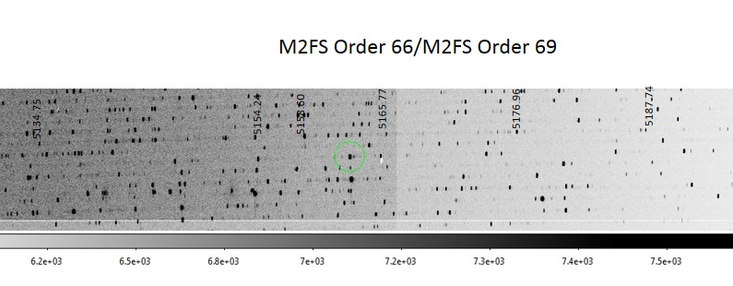
M2FS: Resources to Users. II.
Arc Finding Charts — Available on request for some orders. On request and to be supplemen-ted by users. Also MIKE ThAr atlas can be of use. LoRes atlases not available yet.

Slide 18
M2FS: Data Characteristics. II.
2x2 binning; HiRes; Single order per target.

Slide 19
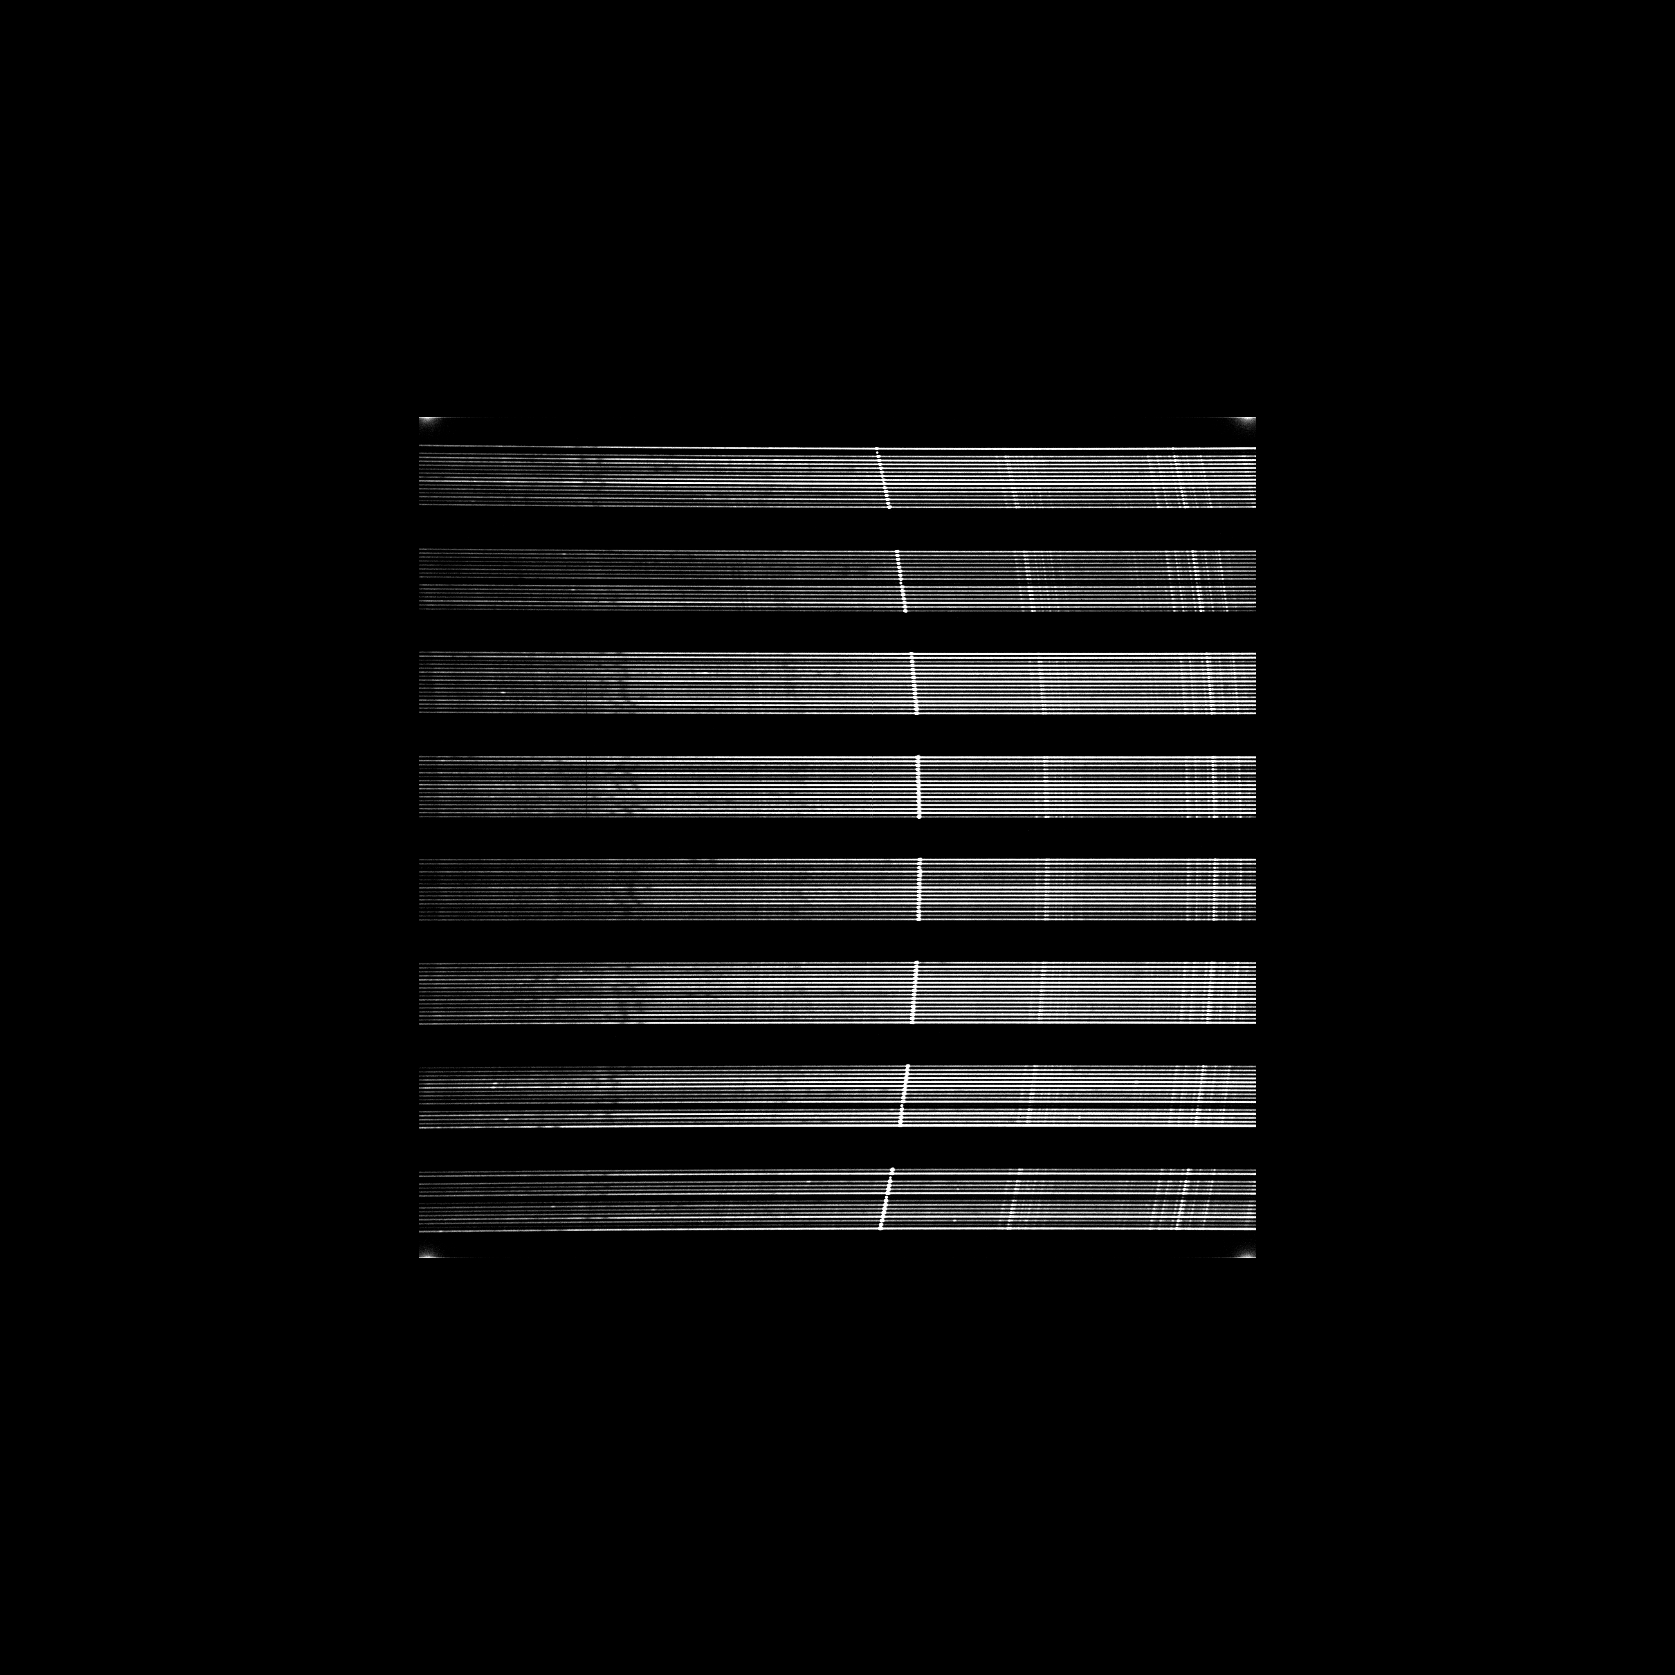
M2FS: Data Characteristics. II.
2x2 binning; LoRes (always single order per target).

Slide 20

M2FS: Data Characteristics. II.
1x2 binning; HiRes; Four orders per target.

Slide 21
M2FS: Data Reduction: Overview
IRAF based processes and Python routines have been developed by MM and JB
Simple command lists available for one-order, HiRes configurations (Mgb and CaT) from MM. Actual IRAF scripts under development. User respository for appropriate software to be developed as demand/availability dictate.
Limited documentation.
Examples here are all IRAF-based and are meant to illustrate key steps.

Slide 22
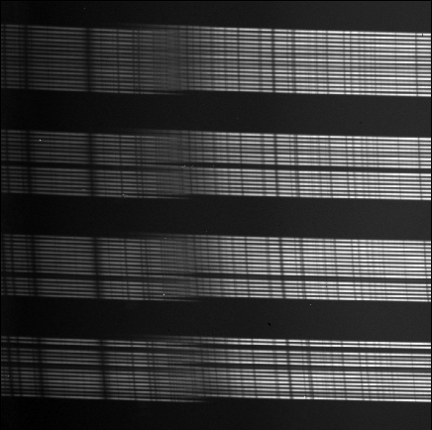
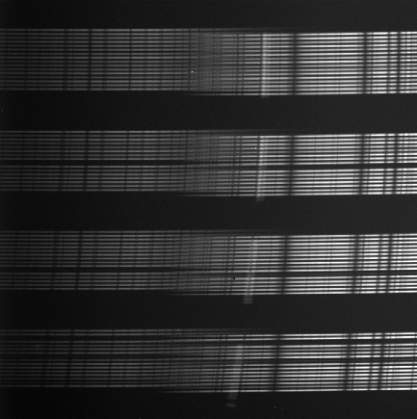
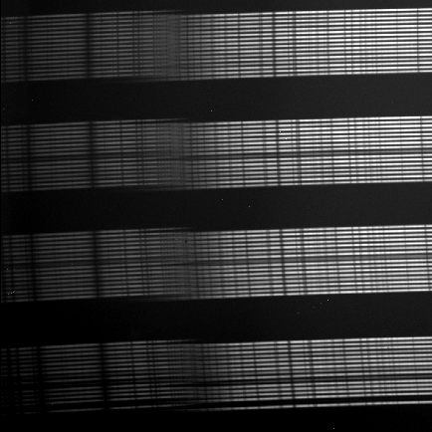
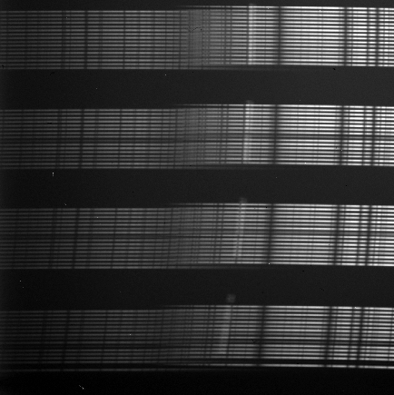
M2FS: Data Reduction: Overview
Process raw images — Line overscan correction (ccdproc).

Slide 23
M2FS: Data Reduction: Overview
Pack images — As needed depending on amplifier/binning choices. Results in single 2-D images with c1 header. (imcreate, imcopy)

Slide 24
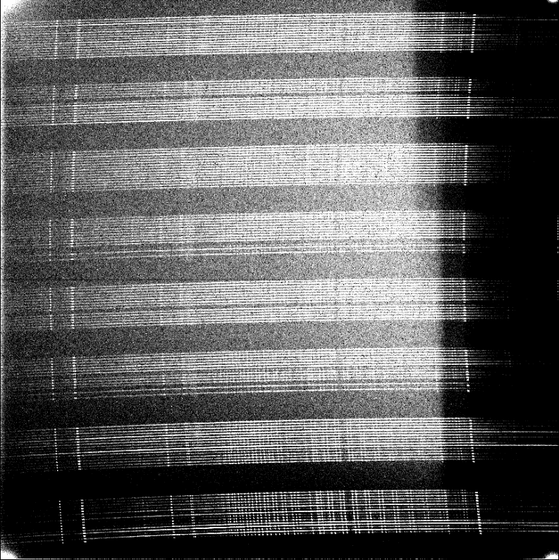
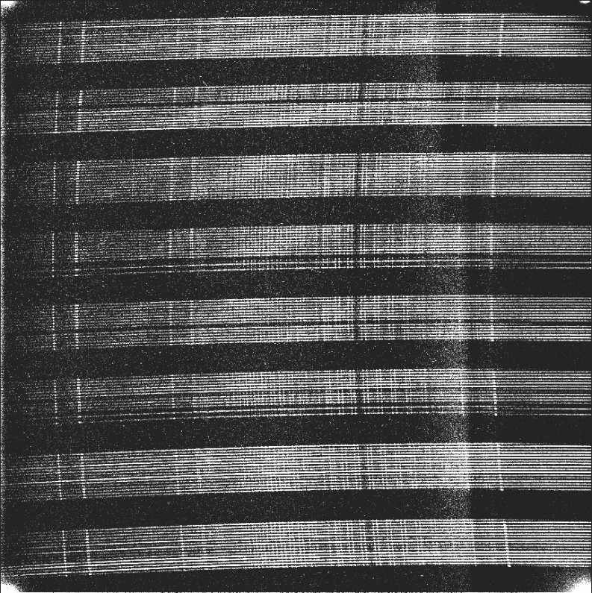
M2FS: Data Reduction: Overview
Scattered light correction — As desired. Scattered light depends on spectrograph, and distribution of target brightnesses. Best practices still in development. (imsurfit)

Slide 25

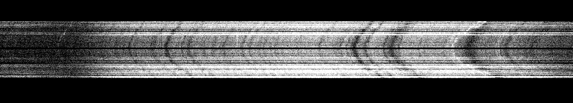

M2FS: Data Reduction: Overview
Tracing orders — (1) Trace appropriate fiber maps for all N fibers for given configuration. (2) Apply trace to data directly or using ‘local’ quartz images as desired. (3) Apply to arcs and any other calibration data/standards. (apall)

Slide 26
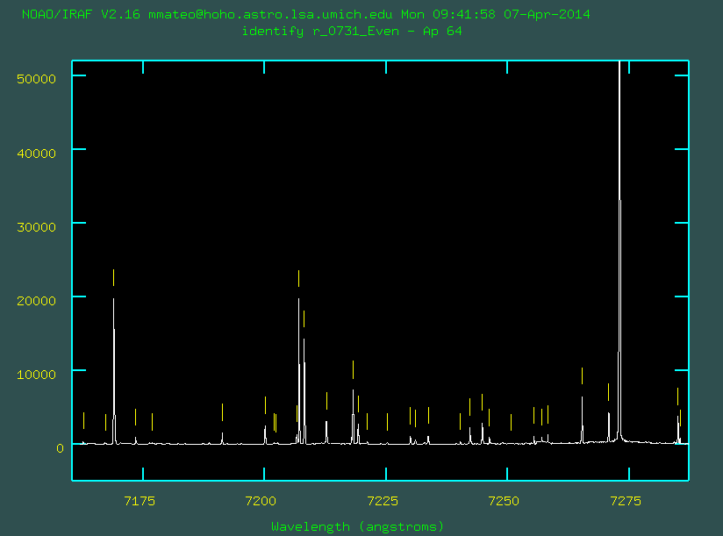
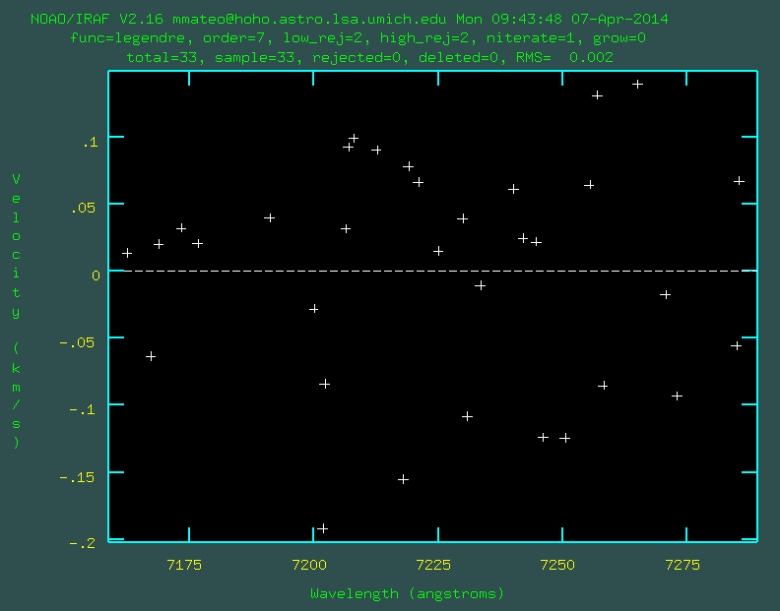
M2FS: Data Reduction: Overview
Identify arc lines — Determine pix-lambda transformation. (identify, reidentify)
HiRes rms ~ 100-300 m/s; LoRes ~ 1 km/s

Slide 27
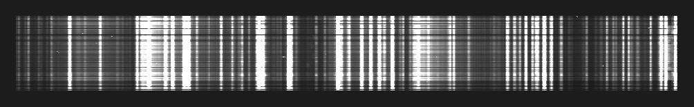
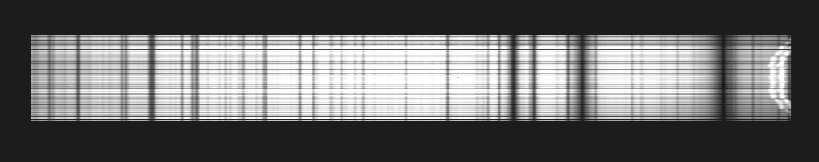
M2FS: Data Reduction: Overview
Dispersion correct data — Apply dispersion cor-rection to data as desired. Can either rebin data or simply place dispersion info in image headers for each fiber/aperture. (refspec, dispcor)

Slide 28
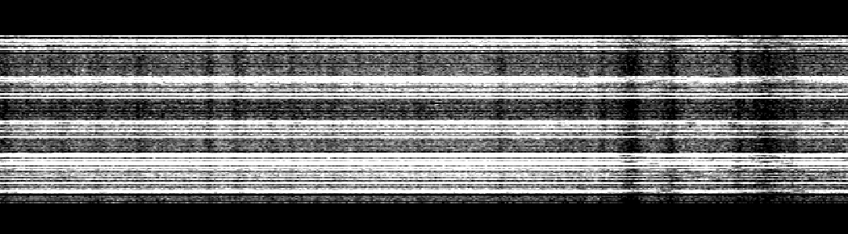

M2FS: Data Reduction: Overview
Fiber corrections/Sky Subtraction — Remove fiber throughput variations. Remove average sky background

Slide 29
M2FS: Data Reduction: Comments
Good velocity precision — Achieving 2-1% of resolution element at even low S/N
Flat fielding — Details still to be worked out
Web pages — Volunteers would be welcome!
At your service for help, advice, additional data as needed.

Slide 30
M2FS: Data Reduction:
Random Samples of
Preliminary Results

Slide 32
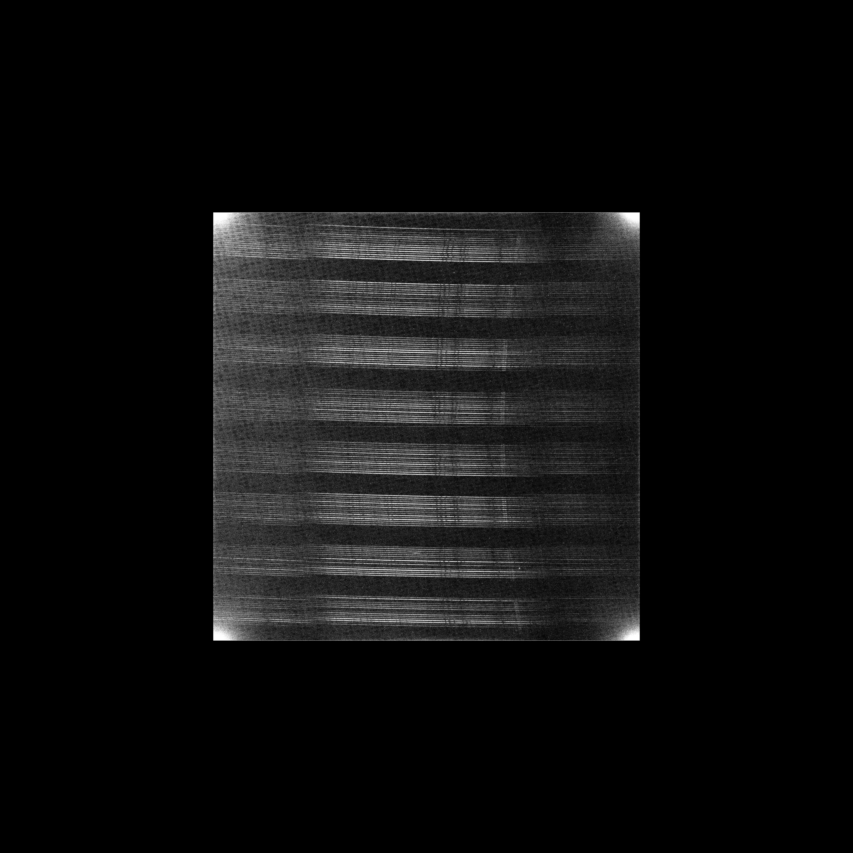

Fornax
Dwarf Galaxy
Dist = 220 kpc
HiRes Spectra
Individual Stars
400 stars/4 hrs

Slide 33
Z ~ 0.57
Abell 267
Galaxy Cluster
z = 0.19
LoRes Spectra
Individual Galaxies
1.5 hrs
Z ~ 0.36

Slide 34
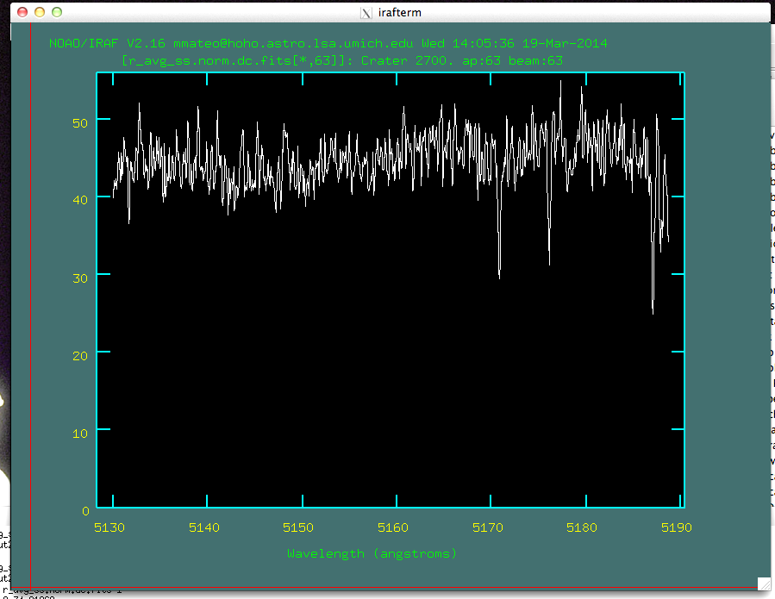
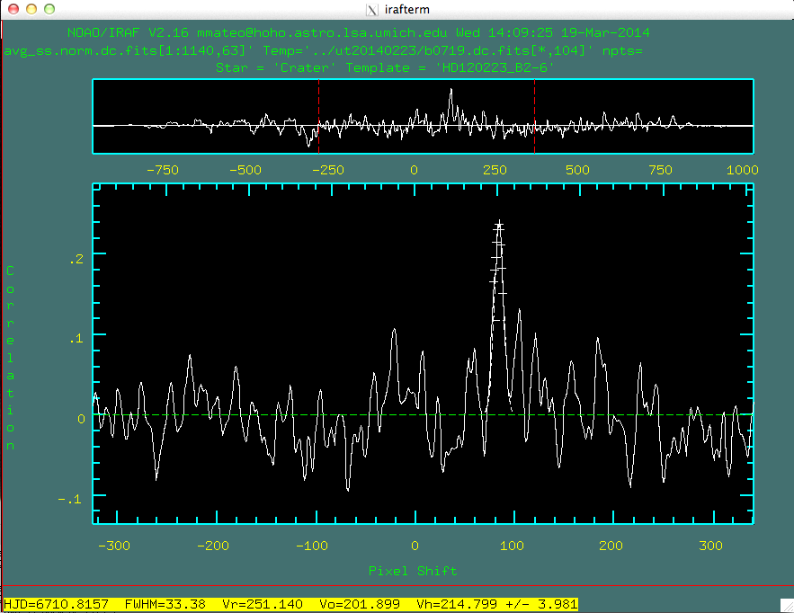
9-10 Solid
Members

